Slide 1
Autonomous Drone Navigation for
Extended Cellular Reception During Disaster Relief Operations
Contributors:
Debbie Liske
Matthew Parker
Teena Thankachan
Sprint 2022 DGMD E-17 - Harvard Extension School - May 9, 2022

Slide 2
Introduction and Background

Slide 3
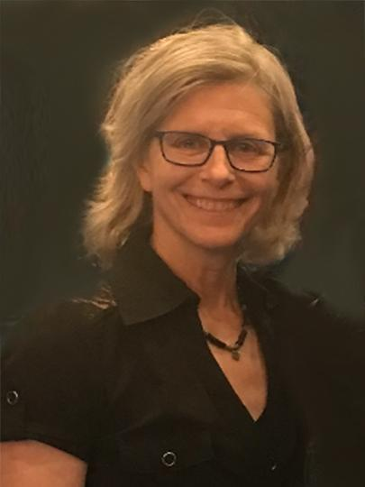
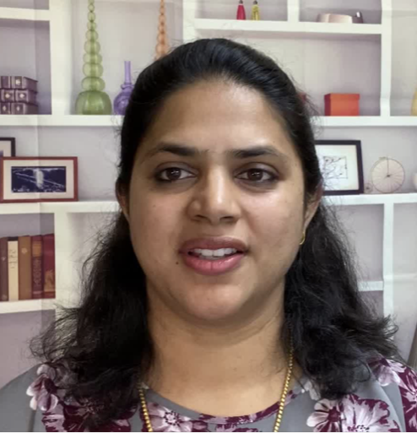
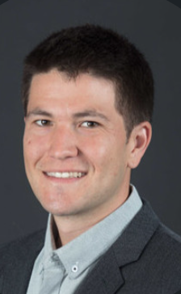
Team Organization
Data Science |  | Data Engineering |  | Simulation, Hardware, and Testing
Debbie |  | Teena |  | Matthew

Slide 4
Presentation Focus
Since the A4 homework and our final project are both drone related, we opted to focus on the Homework submission and then demonstrate some improvements to the autonomous drone operations via the use of deep learning computer vision algorithms
Therefore, this presentation is split into two sections:
Demo of the A4 drone operations
Process to expand and improve autonomous operations

Slide 5
HW A4 Drone Ops

Slide 6
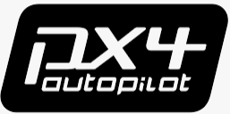


Configuration
This homework expanded on the autonomous driving example by using some new tools and techniques.
PX4 Drone Simulator: Python interface for drone operations
QGround Control: Flight control system
MavLink: Communication protocol

Slide 7
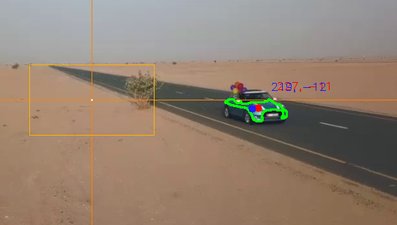
OpenCV Object Detection
Similar to the earlier homework for robot object tracking, an object detection system is required.
Utilize camera
Use basic RGB segmentation and isolate “blue” object
Apply bounding box and find location of the center of the object within the image.

Slide 8
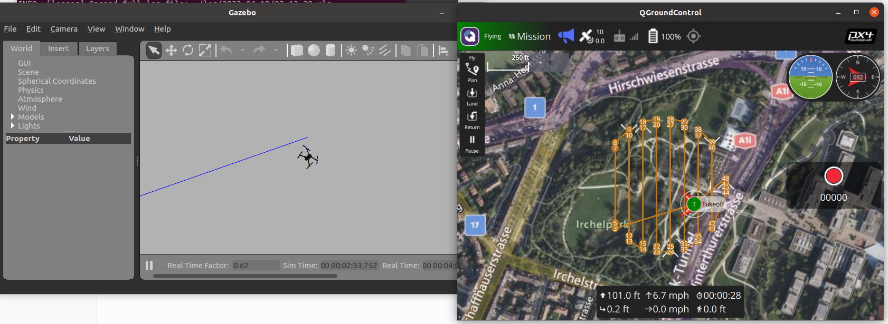
Initial Drone Flights
A model of an Iris drone is loaded into the Gazebo simulator into an empty world.
The QGround Control system interfaces with the PX4 simulator via the use of the MavLink comms protocols and sends commands to the drone.

Slide 9
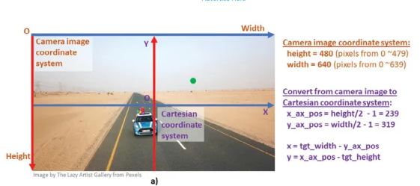
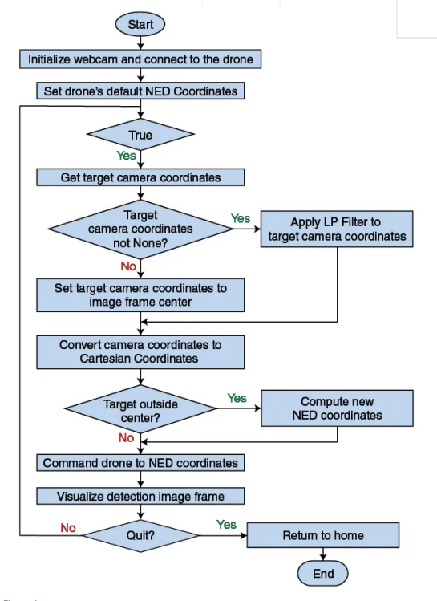
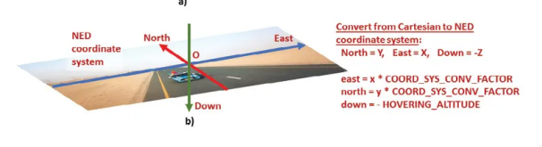
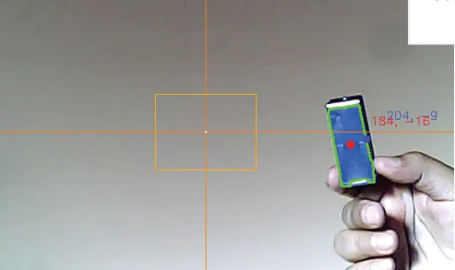
Architecture
Pixel to distance in meters

Slide 10
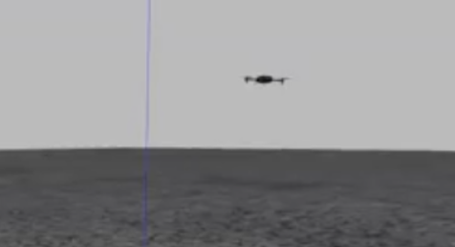
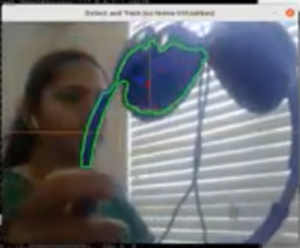
Extend to Drone Camera
To test the code example in simulation, take the following steps:
Use install_run_simmulation.md to install PX4 STIL,MAXSDK-python ,QGroundControl
Run the PX4 & Gazebo, or PX4 & JMAVSim simulator.
Open QGroundControl.
Execute track_and_follow.py script.

Slide 11

Demo Video

Slide 12
Final Project Drone Advancements

Slide 13
Motivations
Roughly 6,800 natural disasters take place every year, around the globe [1].
During those events, cellular communication services may be disrupted and people affected by the disaster may not have an ability to reach out for help.
This project aims to utilize a drone which would, in theory, contain a small mounted cell site that can fly autonomously to a disaster region where towers, or smaller cell sites have been damaged by storms. This would enable more coverage for first responders or those directly affected by the storm who are without (or with poor) cellular service.

Slide 14
Project Objectives
Implement a real-time, deep learning Computer Vision algorithm utilizing an autonomous drone camera
Navigate obstacles on a closed, indoor test track
Land safely on a designated target

Slide 15
Project Details
More information is outlined in a separate XMind file which covers
Project background
Deep learning algorithm Design
Collaboration efforts to create code
Results

Slide 16
Demo Video

Slide 17
Challenges and Future Work

Slide 18
Challenges
Issues with ROS version incompatibility
There are multiple generations of ROS software, each of which is not directly compatible with code syntax.
This caused issues by attempting to extend a ROS program built in an earlier version for this project
The only drones capable of running deep learning code and ROS are expensive (>$1500 USD) which was not feasible for this course
Therefore, focus was placed on simulation only

Slide 19
Future Development Objectives
Get drone system fully functional using software simulator to test and optimize computer vision algorithms
Deploy system to live drone hardware
Want to test full CV system on a real drone on a real-world course
Optimize deep learning algorithm for more advanced navigation techniques in complex environments like natural disaster zones.

Slide 20
Thank you!

Slide 21
References
[1]: Natural Disaster Statistics — The US and the World (2021), https://policyadvice.net/insurance/insights/natural-disaster-statistics/
[2]: ROS 1 Documentation, https://wiki.ros.org/
[3]: Gazebo Simulation Software system, http://gazebosim.org/
[4]: DJI Drone hardware, https://www.dji.com/mini-se/specs
[5]: Onboard SDK for ROS with DJI drone platforms, https://github.com/dji-sdk/Onboard-SDK-ROS
[6]: DJI Mobile SDK now supports Mini 2, Mini SE, Air 2S drones, Jan 2022, https://dronedj.com/2022/01/03/dji-sdk-mini-2-se-air-2s/
[7]: Tech Talk: Untangling The 5 Levels of Drone Autonomy, Mar 2019, https://droneii.com/drone-autonomy
[8]: ROS.org tum_simulator: http://wiki.ros.org/tum_simulator
[9]: https://drone.sjtu.edu.cn/contest/wp-content/uploads/2013/11/ROS_Gazebo_Quadrotor_simulator.pdf (to help understand the initial simulation piece, prior to CV).
[10]:Deep Convolutional Neural Network-Based Autonomous Drone Navigation https://arxiv.org/pdf/1905.01657.pdf
[11]: Deep Neural Network for Autonomous UAV Navigation in Indoor Corridor Environments https://www.sciencedirect.com/science/article/pii/S1877050918310524
[12]: Programming drones with Raspberry Pi on board, easily, Nov 2020, https://www.hackster.io/korigod/programming-drones-with-raspberry-pi-on-board-easily-b2190e

